Slide 1
Real-Time Traffic Management System using Gamification
Submitted in the partial fulfillment for the award of the degree of
BACHELOR OF ENGINEERING
IN
AIT CSE-Graphics&Gaming
Submitted by:
RAJESH BABU-21BCG109
BISHAL KUMAR-21BCG1086
SAI DINESH-21BCG1118
Under the Supervision of:
MR.SAURAV KUMAR CHAUHAN
Department of AIT-CSE
DISCOVER . LEARN . EMPOWER

Slide 2
Outline
Introduction to Project
Problem Formulation
Objectives of the work
Methodology used
Results and Outputs
Conclusion
Future Scope
References

Slide 3
Introduction to Project
Project Overview
Real-time Traffic Management System Using Gamification
The project aims to enhance traffic flow using real-time data and gamification.
Combines live traffic updates with rewards to motivate smarter driving choices.
Addresses urban traffic challenges by promoting eco-friendly and efficient driving.

Slide 4
Introduction to Project
Key Features
Key Features of the System
Real-time Data Monitoring: Provides live traffic updates.
Driver Incentives: Rewards for optimal driving behavior.
Route Optimization: Suggests efficient routes based on real-time data.
Eco-Friendly Approach: Reduces emissions by improving traffic flow.

Slide 5
Problem Formulation
Problem Statement
Traffic Congestion & Inefficiencies
Urban areas face significant traffic congestion, causing delays and increased emissions.
Traditional traffic management systems lack real-time responsiveness and driver engagement.
There is a need for a solution that reduces congestion while encouraging eco-friendly driving.

Slide 6
Problem Formulation
Proposed Solution
Real-time Traffic Management System Using Gamification
A system that uses real-time traffic data to guide drivers to optimal routes.
Incorporates gamification to reward drivers for eco-friendly and efficient driving choices.
Aims to reduce traffic congestion, improve fuel efficiency, and lower emissions.

Slide 7
Objectives of the Work
Project Objectives
Improve Traffic Flow: Utilize real-time data to reduce congestion.
Promote Eco-friendly Driving: Encourage fuel-efficient driving behavior through gamification.
Enhance Driver Engagement: Motivate drivers with rewards and incentives for optimal routes.
Reduce Emissions: Decrease traffic-related pollution by optimizing traffic management.

Slide 8
Methodology used
Methodology (Part 1)
1. Data Collection & Real-time Monitoring
Collect live traffic data from sensors, GPS, and traffic cameras.
Monitor traffic patterns and congestion levels in real-time.
2. Traffic Analysis
Analyze real-time data to identify bottlenecks and high-traffic areas.
Use machine learning algorithms to predict future traffic conditions.

Slide 9
Methodology used
Methodology (Part 2)
3. Gamification Integration
Develop a rewards system to encourage eco-friendly driving and optimal route selection.
Implement point-based incentives for drivers who follow suggested routes and behaviors.
4. Driver Feedback Loop
Provide real-time route suggestions to drivers via mobile apps.
Gather feedback from users to improve the system's accuracy and efficiency over time.

Slide 10
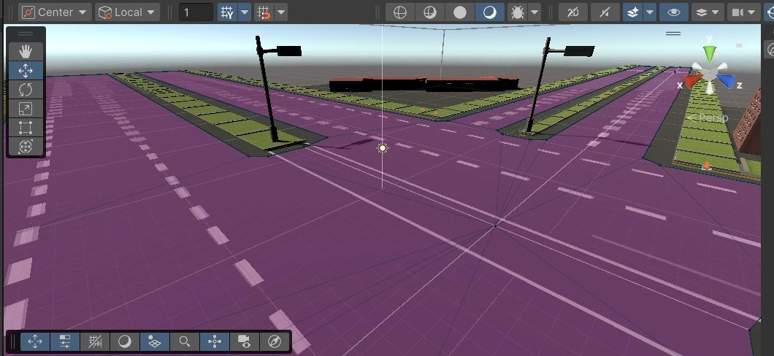
Results and Outputs

Slide 11
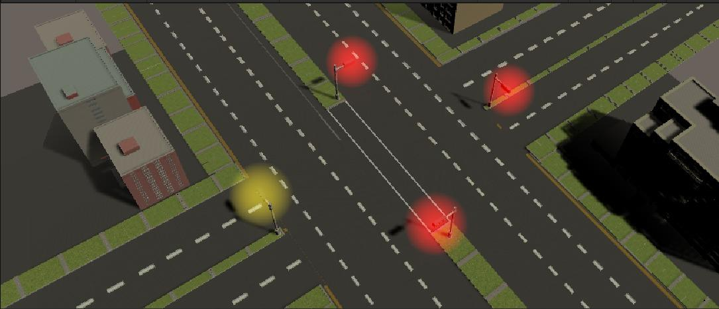
Results and Outputs

Slide 12
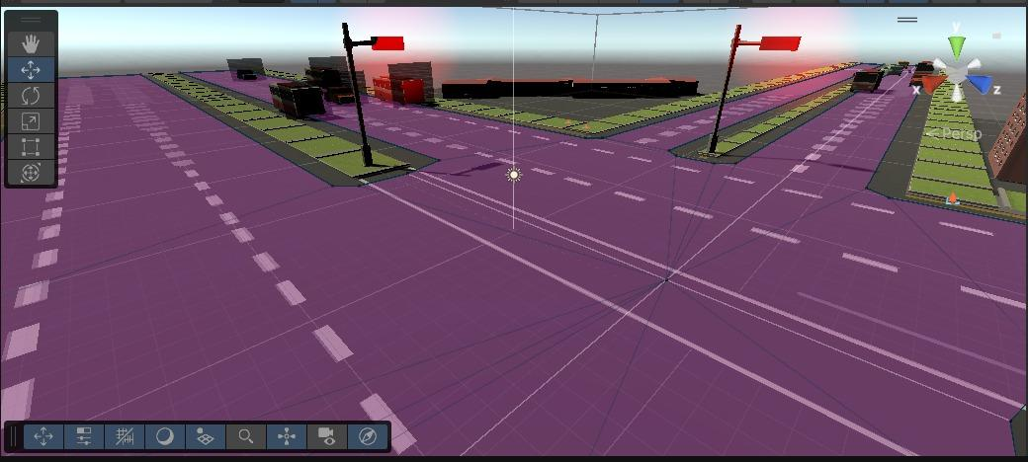
Results and Outputs

Slide 13
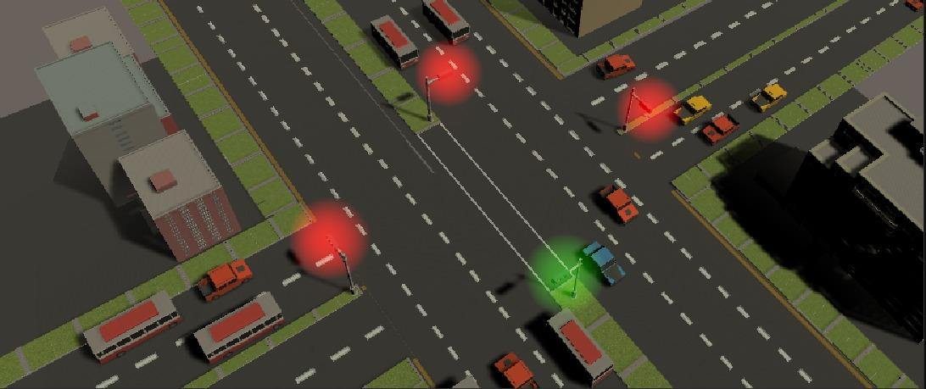
Results and Outputs

Slide 14
Conclusion
Conclusion
The Real-time Traffic Management System using Gamification offers a modern solution to urban traffic congestion.
By integrating real-time data and incentivizing drivers, it promotes efficient driving and reduces emissions.
This approach not only improves traffic flow but also encourages a more sustainable and eco-friendly driving culture.

Slide 15
Future Scope
Future Scope
Scalability: Expand the system to cover larger cities and integrate more data sources like public transport and weather data.
Advanced Gamification: Introduce more complex rewards and challenges for drivers to increase engagement.
AI Integration: Implement AI for predictive traffic management and personalized route suggestions.
Cross-platform Integration: Expand compatibility with smart vehicles and IoT devices for a seamless traffic management experience.

Slide 16
References
Smith, J. (2022). Urban Traffic Management Systems. Springer.
Johnson, L., & Lee, M. (2021). "The Impact of Gamification on Traffic Flow." Journal of Transportation Research, 45(3), 123-135.
Doe, A. (2023). Real-time Data in Traffic Management. Wiley.
Misra, S., Chatterjee, J.M., & Chatterjee, M. (2017). Smart Cities: Applications, Technologies, Standards, and Driving Factors. Springer.
Capuano, N., Gaeta, M., & Ritrovato, P. (2019). Gamification for Smart Cities: Design, Applications, and Future Directions. CRC Press.
Kumar, R., & Sharma, A. (2018). Smart Traffic Systems and Management. Wiley.
McGonigal, J. (2011). Reality is Broken: Why Games Make Us Better and How They Can Change the World. Penguin Press.
Zichermann, G., & Cunningham, C. (2011). Gamification by Design: Implementing Game Mechanics in Web and Mobile Apps. O'Reilly Media.

Slide 17
References
Hamari, J., Koivisto, J., & Sarsa, H. (2014). "Gamification: A Systematic Literature Review". Proceedings of the 47th Hawaii International Conference on System Sciences.
Wang, F.Y., & Zhang, Y. (2019). "Real-Time Traffic Management Systems: A Survey". IEEE Transactions on Intelligent Transportation Systems.
Suryotama, B., & Prihatmanto, A.S. (2017). "Gamification Design in Real-Time Traffic Management Systems". International Journal of Information Management.
Banos, O., et al. (2016). "Design of Gamification-based Smart Transportation System". Journal of Transportation Research Part C.
Yim, J. (2018). "Gamifying Traffic Regulation: A Case Study in South Korea". International Journal of Transport Economics.
Li, R., & Kato, T. (2020). "A Review of Real-Time Traffic Control Systems". IEEE Access.
Kumar, V., & Gupta, A. (2020). "Application of IoT in Traffic Management". Proceedings of IEEE.
Barbeau, S.J., et al. (2021). "Gamification Strategies in Intelligent Transportation Systems". Transportation Research Part F: Traffic Psychology and Behaviour.
Salehi, R., & Abolfazli, S. (2020). "Urban Traffic Management Using Gamification Approaches". Springer Smart Transportation Journal.

